Slide 1
Complete Resume
Solution
By:- Aravinda, Aman, Harsha, Shrihan

Slide 2
Project Objectives
Generate Resumes
Introduced an AI-Powered Platform
Evaluate Resume Quality
Rank Multiple Resumes
Streamline Resume Parsing
Measure Similarity
Offer Job Recommendations
Analyze Skill Gaps

Slide 3
Dataset
Resume Dataset: “InferencePrince555/Resume-Dataset” Hugging Face dataset with more than 30k Resumes.
Job Description Dataset with over 1.6 million job descriptions from various job fields.

Slide 4
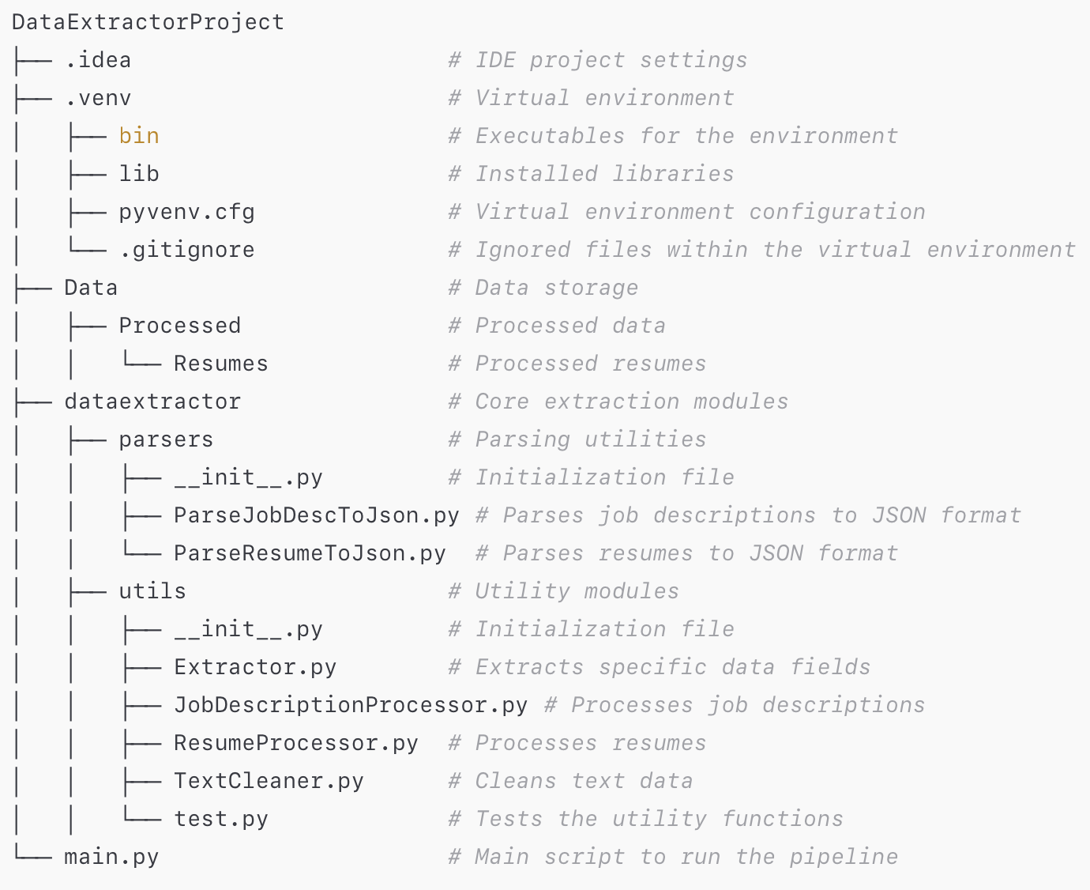
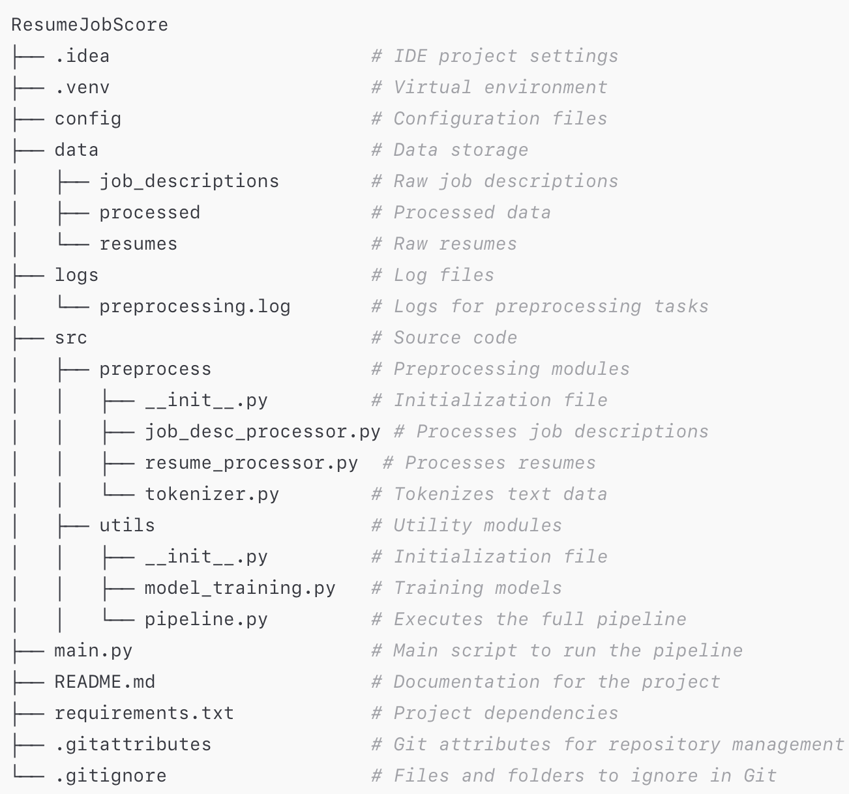
Data Preprocessing and Parsing
Other Preprocessing
Pipeline for Data Extraction
Pipeline for Resume And Jobscore
Gemini API
BERT

Slide 5
Grammatical And Formatting check Model
Grammar Analysis:
Spelling mistakes.
Punctuation errors.
Grammatical inconsistencies.
Formatting Validation:
Consistent font styles and sizes.
Proper alignment of bullet points.
Structured section headers for ATS compatibility.
How It Works:
Input Parsing: Extracts text and layout from the resume.
Formatting Validation: Checks consistency and style adherence.
Feedback Generation: Provides grammar and formatting scores (out of 100) and actionable improvement suggestions.

Slide 6
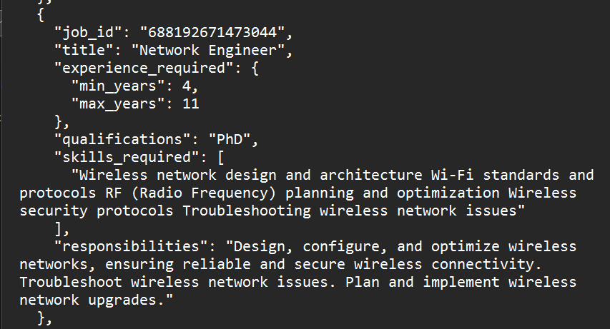
Job recommendation System
Parsing

Slide 7
Job recommendation System
Uses PyPdf to extract text from the resume.
Converts text into numerical vector representations.
Uses Word2Vec to capture semantic meanings
Multi-factor scoring mechanism
Semantic similarity score
Skill match
Work experience score
Weighted combined score
Creates a high-dimensional vector space for matching
Detailed job recommendations including:
Job title
Similarity score
Experience requirements
Qualifications match

Slide 8
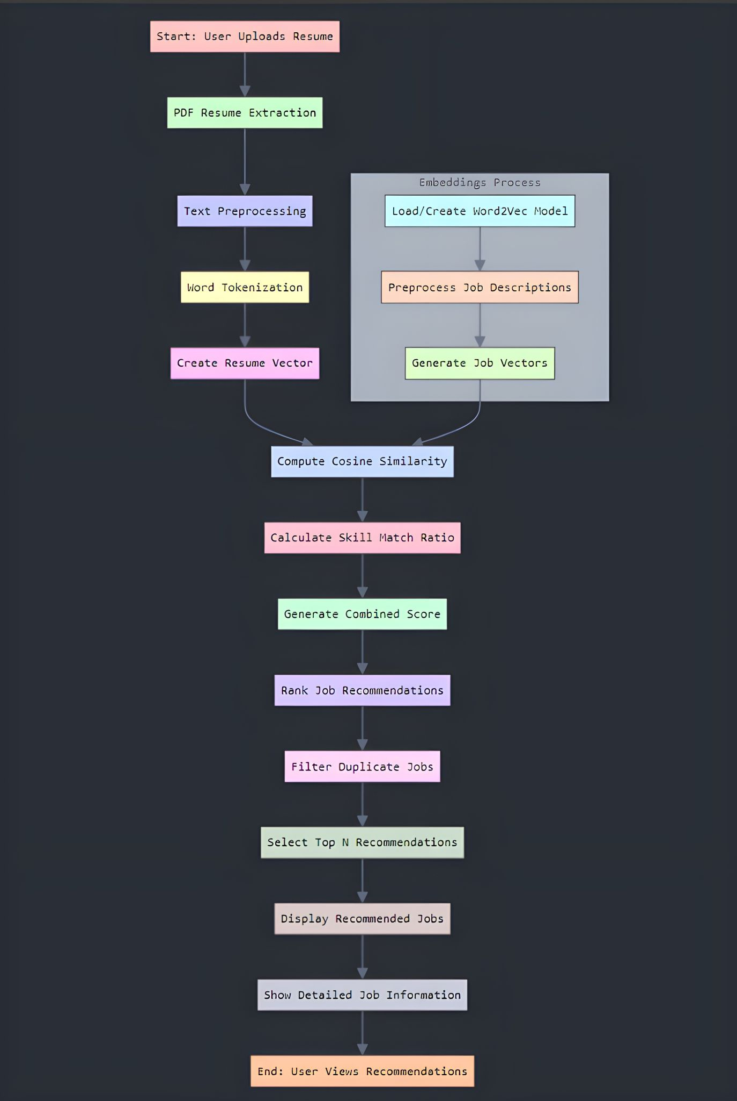
Flow chart of the entire process

Slide 9
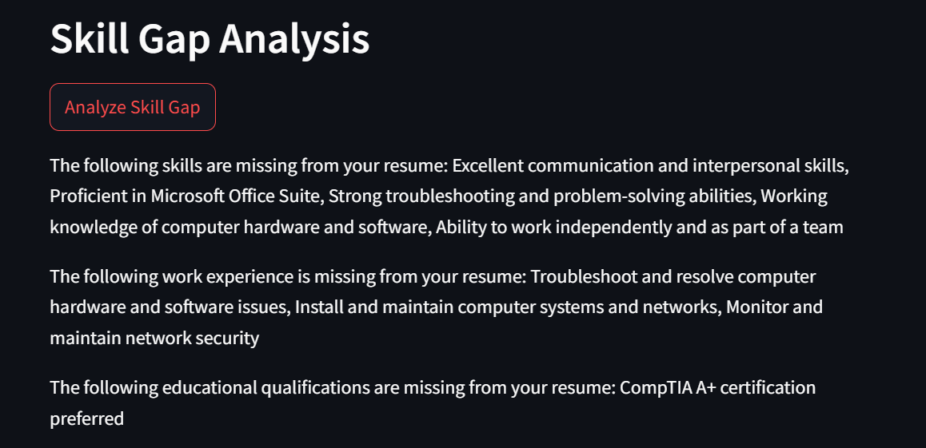
Skill Gap Analysis
Compares a candidate's resume with a job description to identify alignment gaps.
Provides detailed feedback on missing skills, work experience, and education.
Skills Matching: Identifies missing skills by comparing sets of skills from the resume and job description.
Experience Alignment: Uses NLP-based similarity scoring for work experience evaluation.
Education Analysis: Matches educational qualifications like degrees and institutions.
spaCy (en_core_web_md): For natural language processing and similarity scoring.
JSON Parsing: For structured data extraction from resumes and job descriptions.

Slide 10
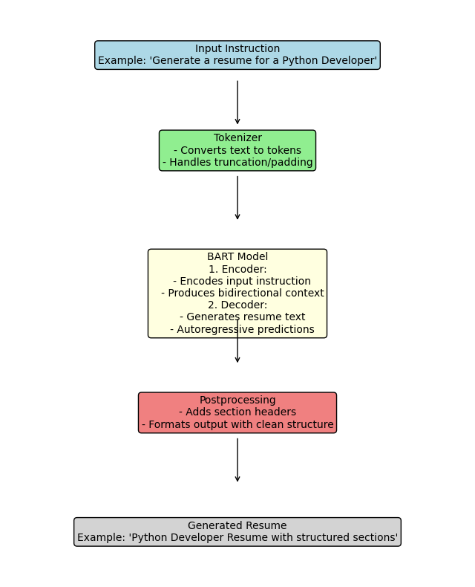
Resume generation
Model Development
Designed and implemented a pretrained BART-based sequence-to-sequence model for automated resume generation.
Preprocessed over 32,000 resume records by cleaning, structuring text into key sections such as "Work Experience" and "Education."
Applied text generation techniques using parameters like top_k, top_p, temperature, and repetition_penalty to balance creativity and coherence.
Training
Conducted training using the facebook/bart-base model with a sequence length of 1024.
Optimized the training process with:
Gradient accumulation for handling larger batch sizes.
Mixed precision training for faster computation and reduced GPU memory usage.
Dynamic padding to maximize efficiency during tokenization and batching.

Slide 11
Resume generation
Evaluation
Evaluated the model using BLEU scores for alignment between generated and reference resumes.
Bleu score of .7 on randomly selected 500 samples using the SacreBLEU library
Conducted manual reviews for qualitative analysis, ensuring correctness of sections like "Skills" and "Experience."
Addressed overfitting by incorporating regularization techniques such as repetition penalties and beam search.
The model demonstrates decent performance across the majority of resume types.
Successfully generates resumes with structured sections such as:
Work Experience
Education
Skills
Adjusted training parameters (e.g., top_k, top_p, repetition penalty) to fine-tune performance.

Slide 12
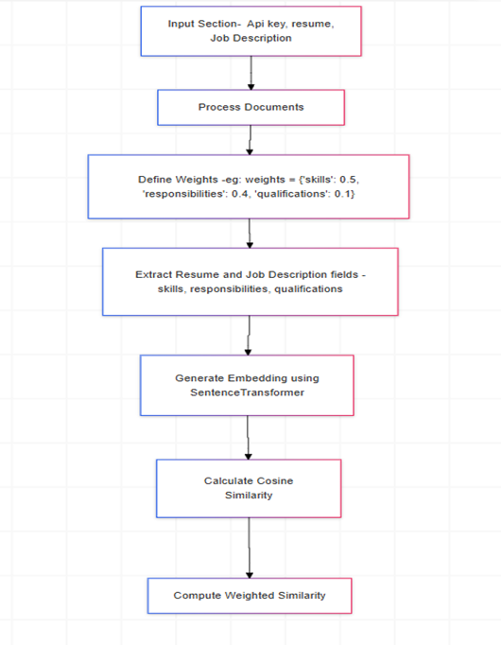
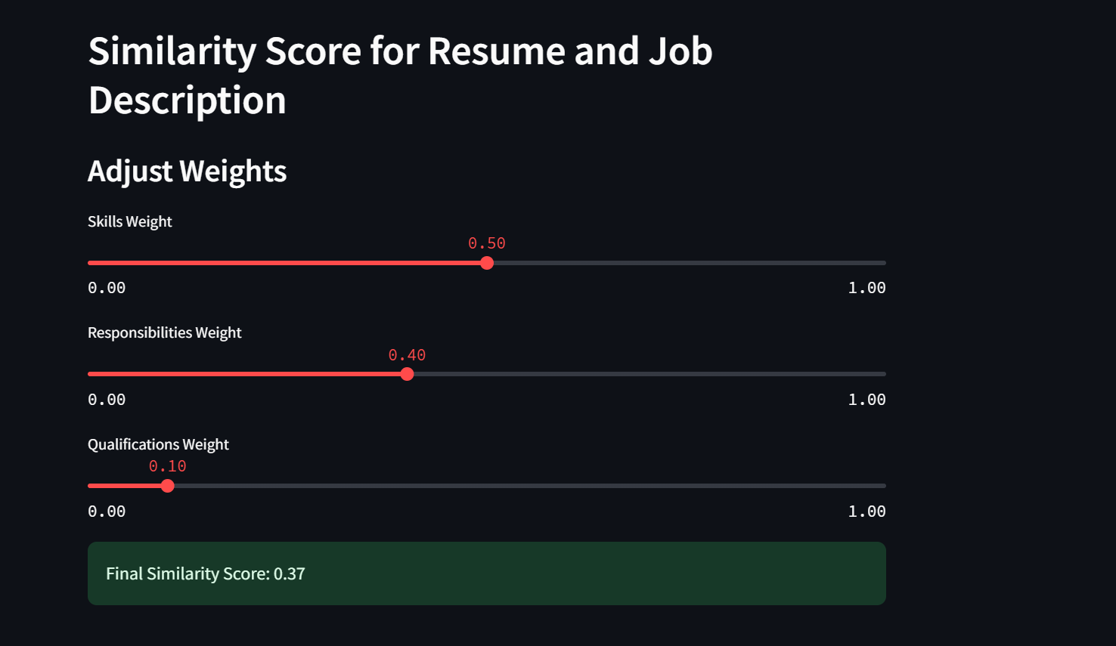
Weighted Similarity Analysis Between Resume and Job Description

Slide 13
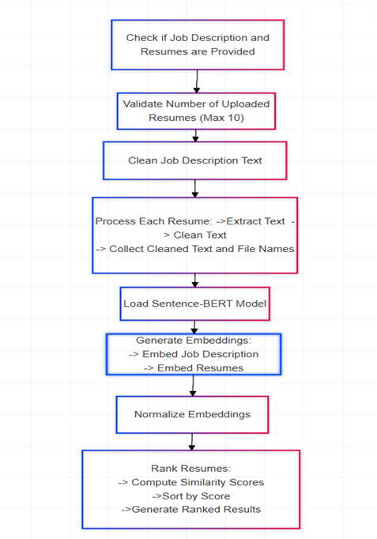
Ranking Resumes based on Job Description

Slide 14
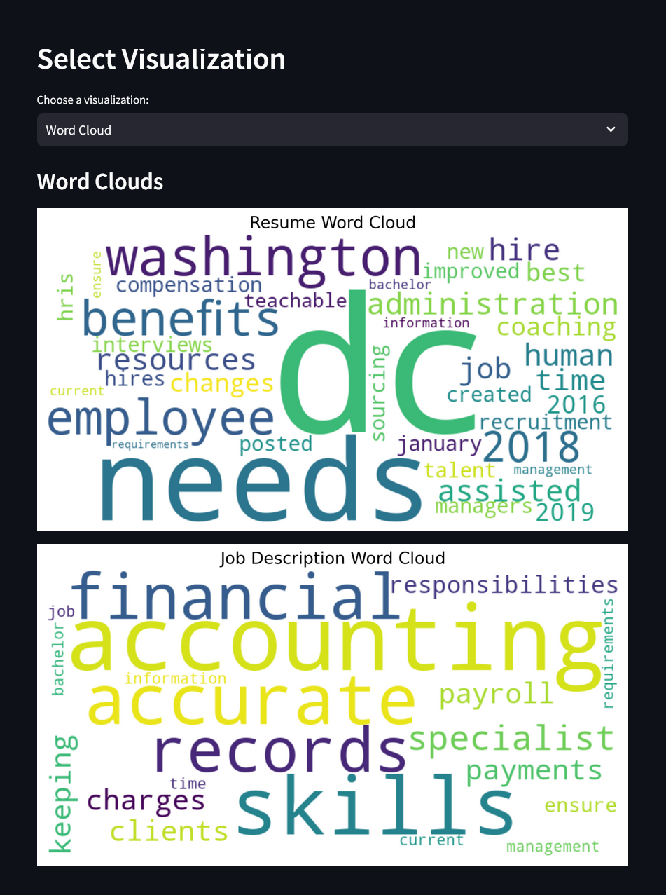
Word Cloud for Resume and job description

Slide 15
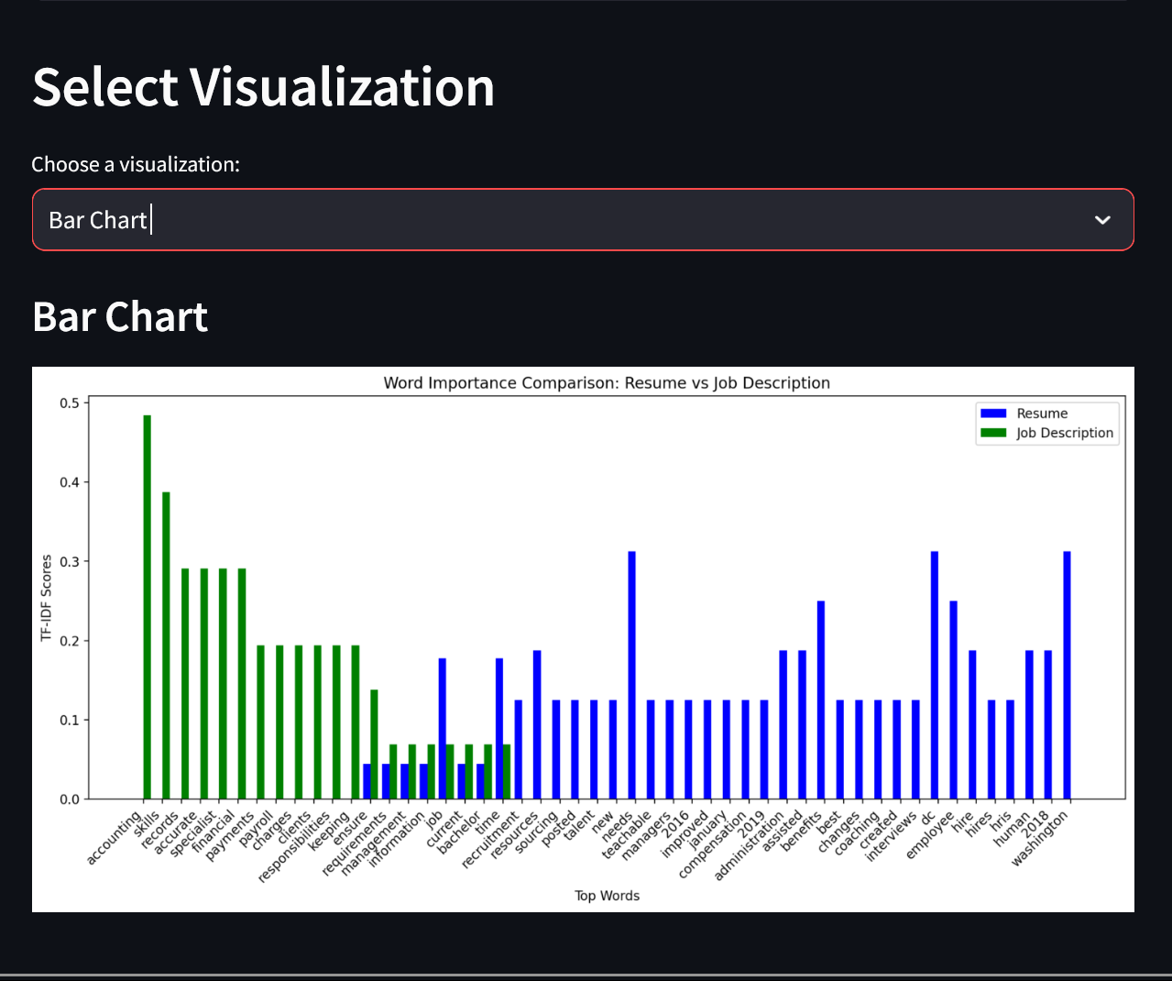
Bar chart displaying TF-IDF score of words from resume and job description

Slide 16
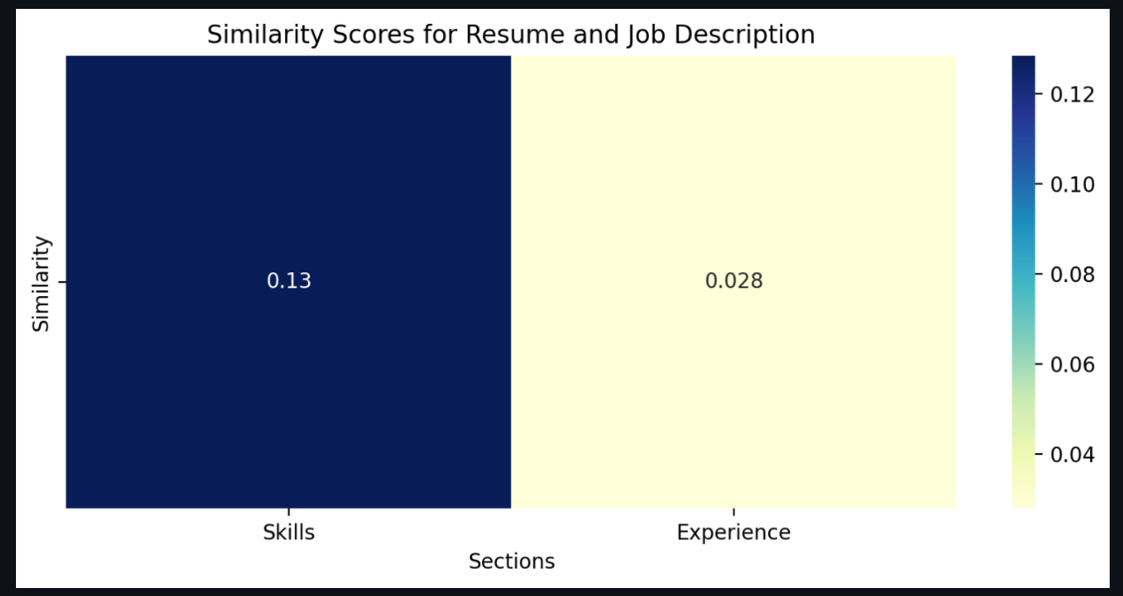
Heatmap for similarity score of skills and experience

Slide 17
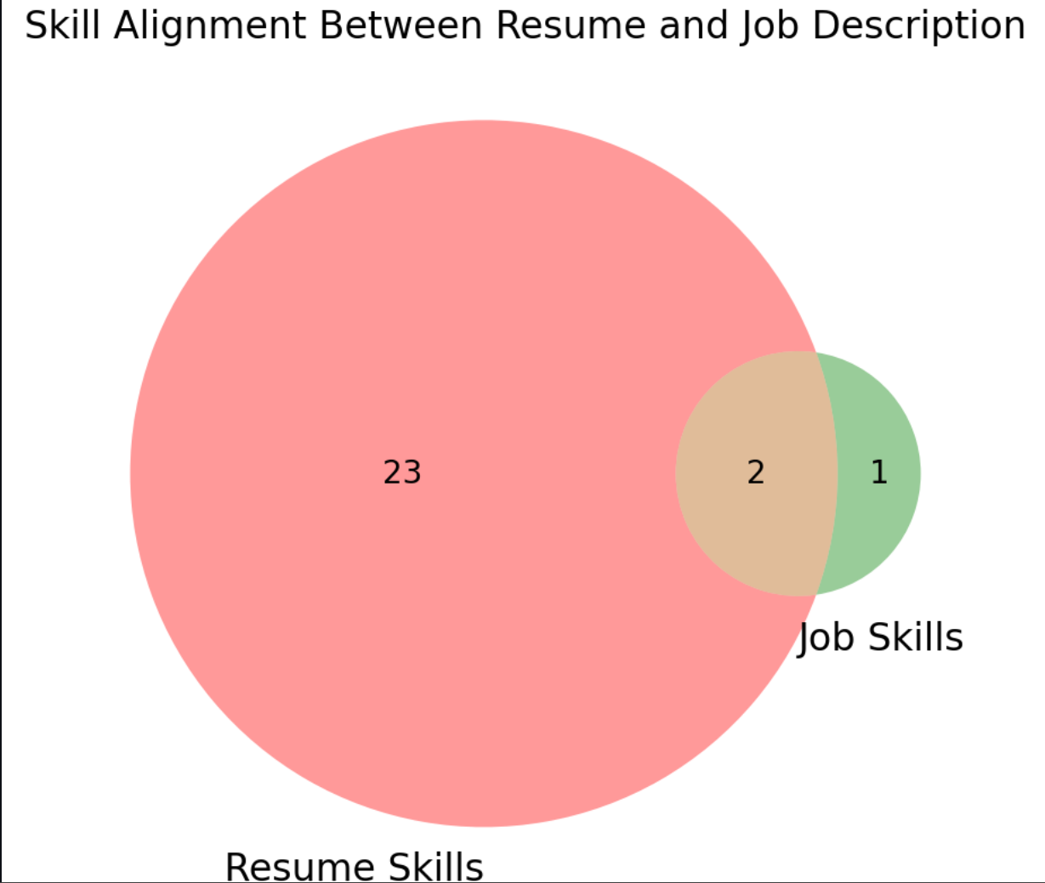
Venn Diagram for skills alignment

Slide 18
Future Scope and Conclusion
Similarity
Enhance Matching Algorithms: Incorporate machine learning to dynamically adjust similarity weights based on user feedback.
Job Recommendation
Personalized Suggestions: Develop a recommendation engine that tailors job listings to individual user profiles and preferences.
Resume Generator
Interactive Customization: Add customizable templates and real-time preview options for more personalized resume creation.
Ranking Resume
Real-Time Feedback: Implement a system that provides instant rankings and actionable feedback to improve resume alignment with job descriptions.
Grammar Check
Context-Aware Corrections: Integrate advanced grammar and style checkers that understand the context to enhance resume professionalism.

Slide 19
Thank You

